Slide 1
Dealing with Different Data Formats
O2

Slide 2
What Are Annotations/Labels?
Image annotation is the task of labeling digital images, typically involving human input and, in some cases, computer-assisted help.
Labels are predetermined by a machine learning (ML) engineer and are chosen to give the computer vision model information about the objects present in the image.
Following that, a machine learning algorithm—often referred to as training a model—is given the output data, also known as structured data.
1. Manual Data Annotation/Labeling: involves human annotators who manually review and label data points according to predefined criteria or guidelines.
2. Automatic Data Annotation/Labeling:The process by which a computer system automatically provides metadata to the data in the form of captions or keywords.
Notes:
In the image, data annotation is performed to organize and find relevant photos from a database, and image retrieval systems leverage this application of computer vision algorithms

Slide 3
Types of Annotation
01
02
03
04
05
06
Bounding Box Annotation
Polygon Annotation
Cuboid Annotation
Key Points Annotation
Text Annotation
Semantic Segmentation

Slide 4
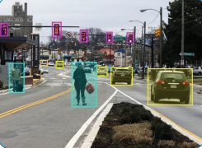
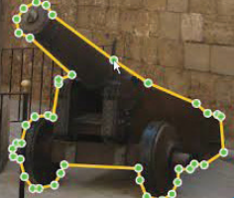
Types of Annotation
01
02
Bounding Box Annotation
It involves using an image to create a rectangle drawing by connecting an object's corners to its edges.
Polygon Annotation
are high-precision annotations on an object's boundaries in a f
rame, used for identifying items like street signs, logos, and faces.

Slide 5
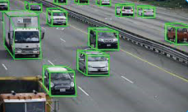

Types of Annotation
03
04
Cuboid Annotation
high-quality labeling and marking used in this style of 3D annotation to emphasize 3D drawing shapes, aid in identifying space, volume and measure the depth or distance of objects
Key Points Annotation
used to annotate highly particular elements, such as face features, bodily parts, and positions on top of the target object.
Notes:
Cuboid annotations: are frequently used in construction and medical imaging because they aid in identifying space and volume and are used to measure the depth or distance of objects, like buildings or automobiles.
Semantic Segmentation : In other words, each pixel in an image is classified into a specific class or category based on its features or attributes. This enables the identification of objects, backgrounds, and other regions in an image

Slide 6
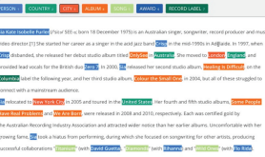
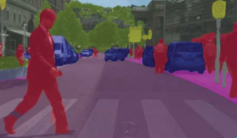
Types of Annotation
05
06
Text Annotation
text annotation helps identify words or sentence patterns by adding labels to a text document, In order for the model to comprehend the language, intent, and even emotion behind the words
Semantic Segmentation
computer vision technique that involves dividing an image into multiple segments or regions based on the semantic meaning of each pixel.

Slide 7
Formats of data annotation
data annotation
COCO
YOLO
PASCAL VOC
JSON File
Txt File
XML File

Slide 8
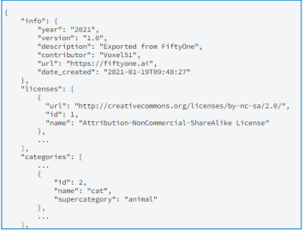
01
02
Common Objects in Context (COCO)
COCO is a huge image dataset collected for object detection, segmentation, and person key points detection, the annotations are stored using JSON .
Coordination: Centralized - [x , y , width , height]
Method of recording the boundaries of object: polygon-based
Speed: slow
You Only Look Once (YOLO)
In YOLO labeling format, a .txt file with the same name is created for each image file in the same directory. Each .txt file contains the annotations for the corresponding image file .
<object-class> <x> <y> <width> <height>
Coordination: Centralized - [x , y , width , height]
Method of recording the boundaries of object: Grid-based
Speed: very fast

Slide 9
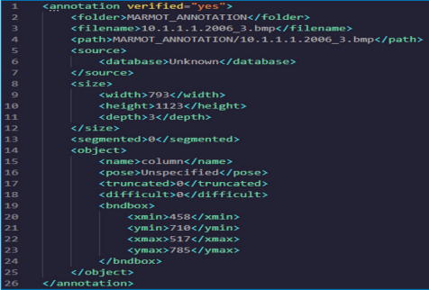
03
PASCAL VOC
PASCAL VOC is a data annotation format that stores annotation information in XML format. each image requires an XML file. it provides image datasets for over 20 classes that use object detection, semantic segmentation
Coordination: Distributed - [xmin , ymin , xmax, ymax]
Method of recording the boundaries of object: Rectangle-based
Speed: Fast

Slide 10
Image Annotators
- LabelMe tool .
- - Installation:
- - Basic Operations:
- - - Annotation:
- - - Visualization:
- - - Semantic Segmentation:
- - - Instance Segmentation:
conda create --name=labelme python=3
conda activate labelme
pip install labelme
labelme apc2016_obj3.jpg -O apc2016_obj3.json
labelme_draw_json apc2016_obj3.json
labelme data_annotated –labels labels.txt –nodata
labelme data_annotated –labels labels.txt –nodata

Slide 11
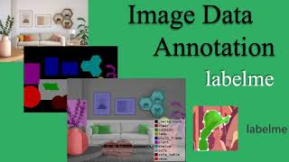
Image Annotators
- LabelMe tool .

Slide 12
Text Annotation
Text annotation is the process of adding metadata or labels to text data to provide additional context and meaning to the content.
There are several types of text annotation, including:
1. Named Entity Recognition (NER): NER is a type of text annotation that involves identifying and classifying named entities such as people, organizations, locations, and dates within a text
2. Part-of-Speech (POS) Tagging: POS tagging involves labeling each word in a text with its corresponding part of speech, such as noun, verb, adjective, adverb, etc.
3. Sentiment Analysis: Sentiment analysis is the process of determining the emotional tone or sentiment expressed in a text. This type of annotation is commonly used in social media analysis and customer feedback analysis.

Slide 13
Text Annotation
There are several types of text annotation, including:
4. Dependency Parsing: Dependency parsing is a technique used to analyze the grammatical structure of a sentence by identifying the relationship between words in a sentence.
5. Coreference Resolution: Coreference resolution is the process of identifying when two or more words or phrases in a text refer to the same entity.
6. Text Classification: Text classification involves categorizing text documents into predefined categories based on their content.
7. Event Extraction: Event extraction is the process of identifying events described in text and their associated attributes, such as the participants, time, location, and other relevant details.
Notes:
5. Coreference Resolution: Coreference resolution is the process of identifying when two or more words or phrases in a text refer to the same entity. In each of these sentences, there is a pronoun or noun phrase that refers back to another entity mentioned earlier in the sentence. Coreference resolution involves identifying those referring expressions and linking them to the entities they refer to.

Slide 14
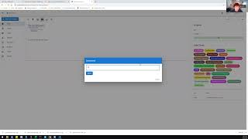
Text Annotation
- Doccano Text Annotation Tool
Article on medium : https://shorturl.at/fpP48

Slide 15

Convert One Data Format into Another
- Using roboflow
Another Video : https://rb.gy/9owdyr

Slide 16
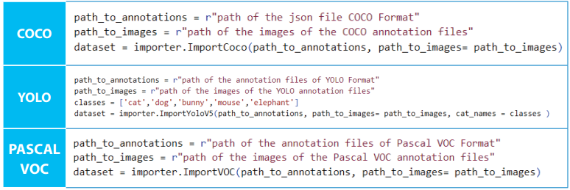
Convert One Data Format into Another
- Using code
Step 1:
pip install pylabel
From pylabel import importer
Step 2:

Slide 17
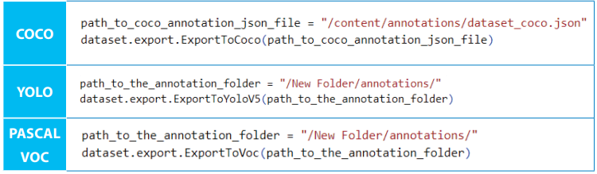
Convert One Data Format into Another
- Using code
Step 3:

Slide 18
Correcting quality issues in data
O3

Slide 19

Error Correction
Data corruption refers to any unwanted change that happens to the data while being transmitted or processed
How to correct errors in data in a form of a table?
We have two:
The first approach uses an existing tool like Microsoft Excel
The second approach uses programming.

Slide 20
Error Correction Using Microsoft Excel
01
02
Excel Sorting
Excel Text
03
04
Remove Duplicates
Conditional Formatting
The Sort Ascending and Sort Descending commands can be used to sort ranges
Text to Column
Change Case
Find and Replace
Duplicating data might occasionally be helpful
Delete all formatting
Highlight errors

Slide 21
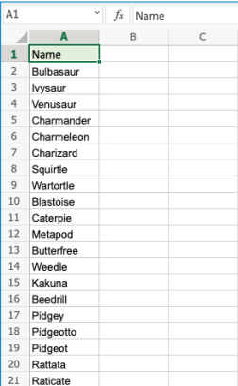
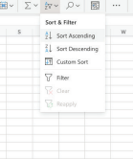
Excel Sorting
1. Select A2:A21
2. Click on the
“Sort & Filter” menu.
3. Choose Sort Ascending

Slide 22
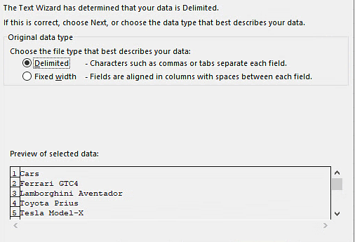
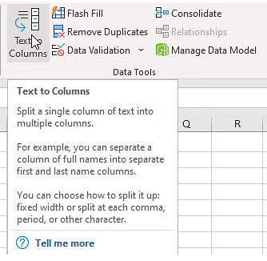
Excel Text
Text to Column

Slide 23
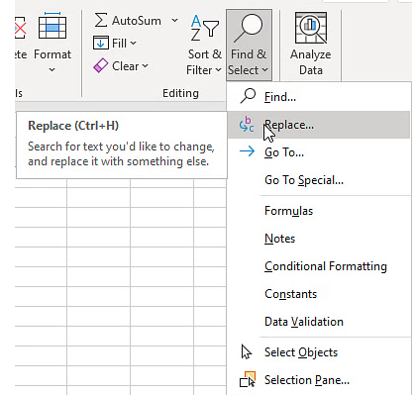
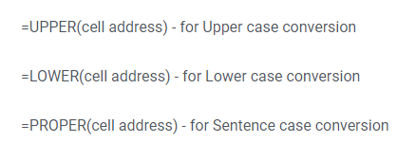
Excel Text
Find and Replace
Change Case

Slide 24
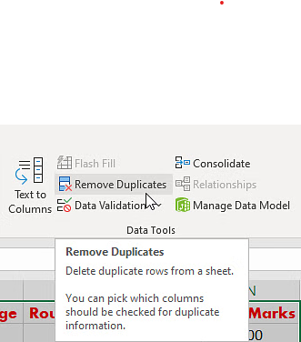
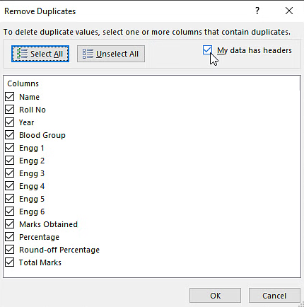
Remove Duplicates

Slide 25
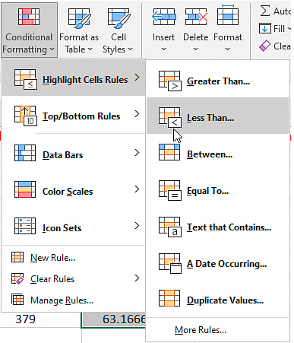
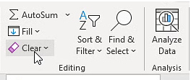
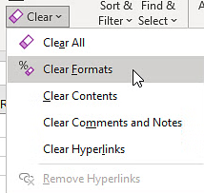
Conditional Formatting
Delete all formatting
Highlight errors

Slide 26
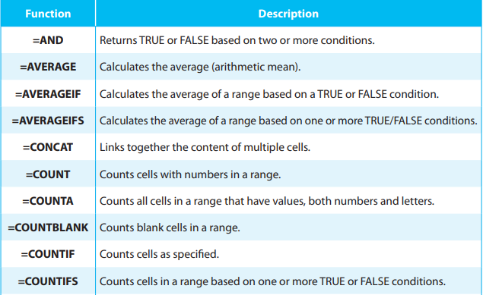
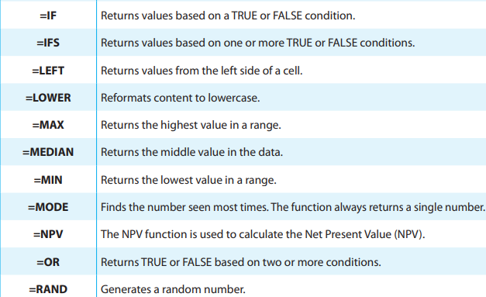
Functions

Slide 27
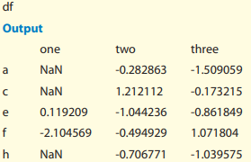
Error Correction Using Python
import pandas as pd
import numpy as np
df = pd.DataFrame({'one': [np.nan, np.nan, 0.119209, -2.104569, np.nan],
'two': [-0.282863, 1.212112, -1.044236, -0.494929, -0.706771],
'three': [-1.509059, 0.173215, -0.861849, 1.071804, -1.039575]},
index=["a","c","e","f","h"],)

Slide 28
Error Correction Using Python
we can do simple function on it like :
df["one"].sum() >>>> to sum the first column
df.mean(1) >>>> to calculate the mean of rows
df.cumsum() >>>> to sum the row with upper row and ignore nan value
df.cumsum(skipna=False) >>>> to sum the row with upper row with nan value

Slide 29
Error Correction Missing Values
df["one"] >>>> to show the first column.
pd.isna(df["one"]) , df.isna() >>>> to print true in nan value.
df["four"].notna() >>>> to print false in nan value.
pd.Series([1, 2, np.nan, 4], dtype=pd.Int64Dtype())
Using to create column of integers with even one missing value .
df["timestamp"] = pd.Timestamp("20120101") >>>> Datetimes
df2.loc[[“a”, “c”, “h”], [“one”, “timestamp”]] = np.nan
Using to create NaN values in (one ,timestamp) columns

Slide 30
Error Correction Missing Values
Filling Missing Values:
df.fillna(0) >>>> to replace NA with a scalar value (0).
df["one"].fillna("missing") >>>> to replace NA with a scalar value (missing)
df.fillna(method="pad", limit=1) >>>> fill the value from top row to
the next row one time.

Slide 31

Replace Using Statistics
Mean
Median
The value in the middle, after sorting all values ascending
The average value (the sum of all values divided by a number of values).
Mode
The value that appears most frequently

Slide 32

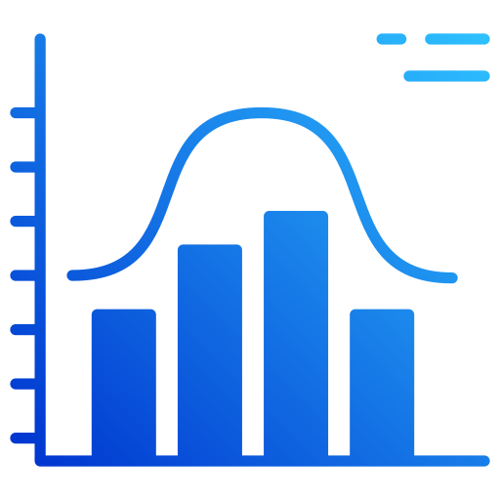

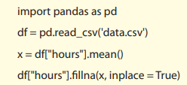
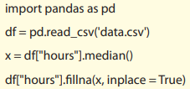
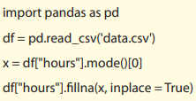
Replace Using Statistics
MEAN
MEDIAN
MODE

Slide 33
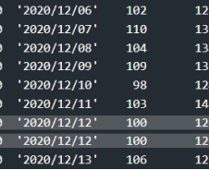
Duplicate Values
With function
The duplicated() function may be used to find duplicates. For each row, the duplicated() function returns a Boolean value.
print(df. duplicated())
To remove duplicates, use the drop_duplicates() method df.drop_duplicates(inplace = True)

Slide 34

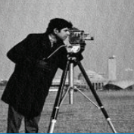


Correct Images
Enhancement
Segmentation
This is the process of adjusting digital images so that the results are more suitable for display
This process divides the image into regions of pixels that are represented by a labeled image

Slide 35
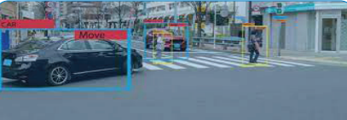
Correct Images
Image Labeling
This process divides the image into regions of pixels that are represented by a labeled image
Run the following command
labelme apc2016_obj3.jpg -O apc2016_obj3.json
2. Then right-click on any polygon required
3. The last step is to save the file

Slide 36

Thanks!
Do you have any questions?
additional resources
https://www.simplilearn.com/tutorials/excel-tutorial/excel-data-cleaning
https://realpython.com/python-data-cleaning-numpy-pandas/

Slide 37
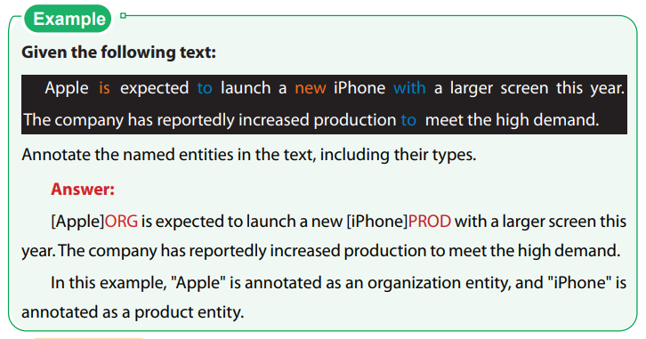
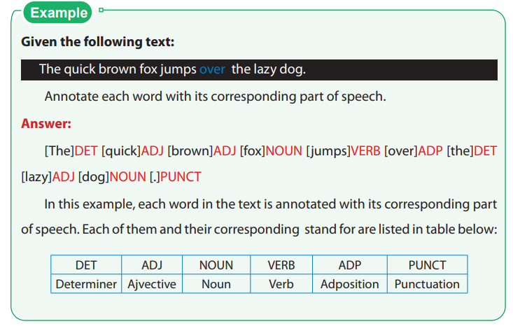
Text Annotation
1- Named Entity Recognition (NER)
2- Part-of-Speech (POS) Tagging

Slide 38
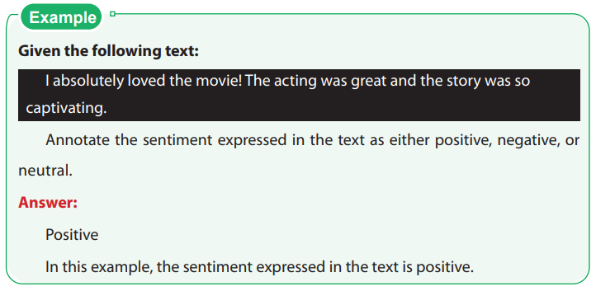
Text Annotation
3. Sentiment Analysis

Slide 39
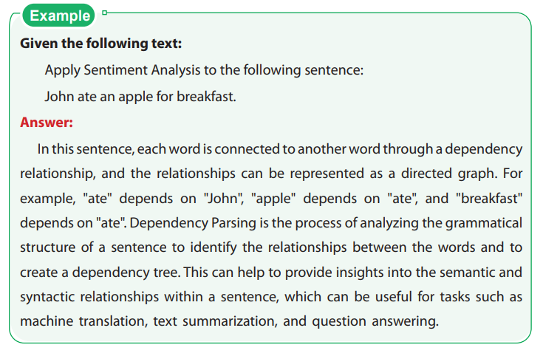
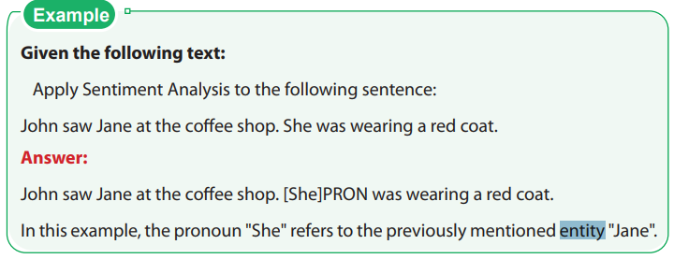
Text Annotation
4. Dependency Parsing
5. Coreference Resolution

